Slide 1
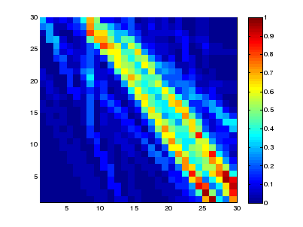
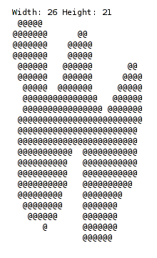
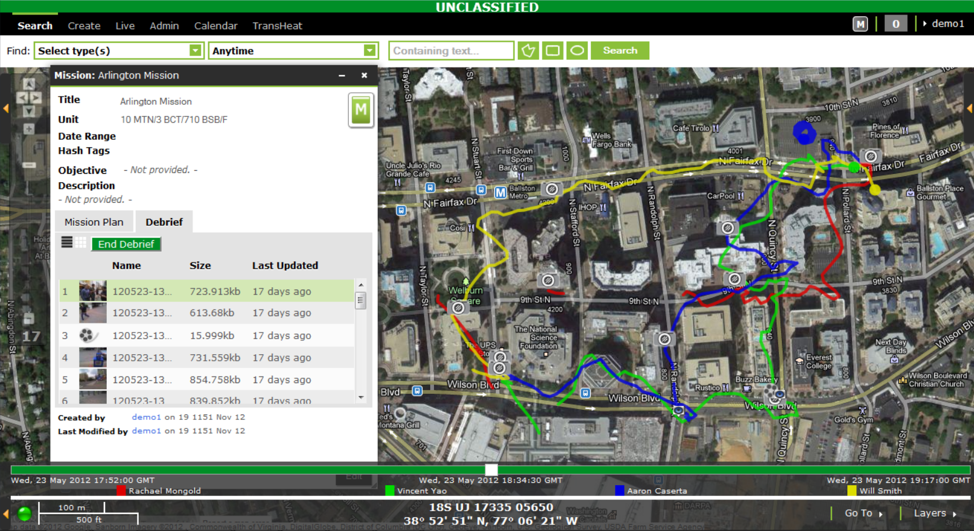
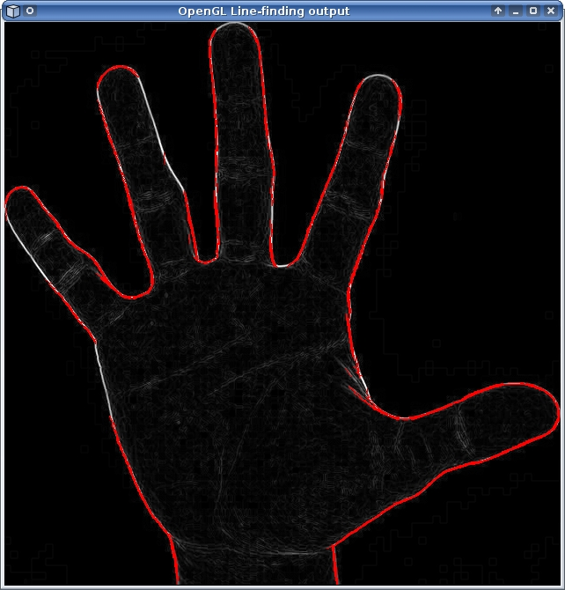
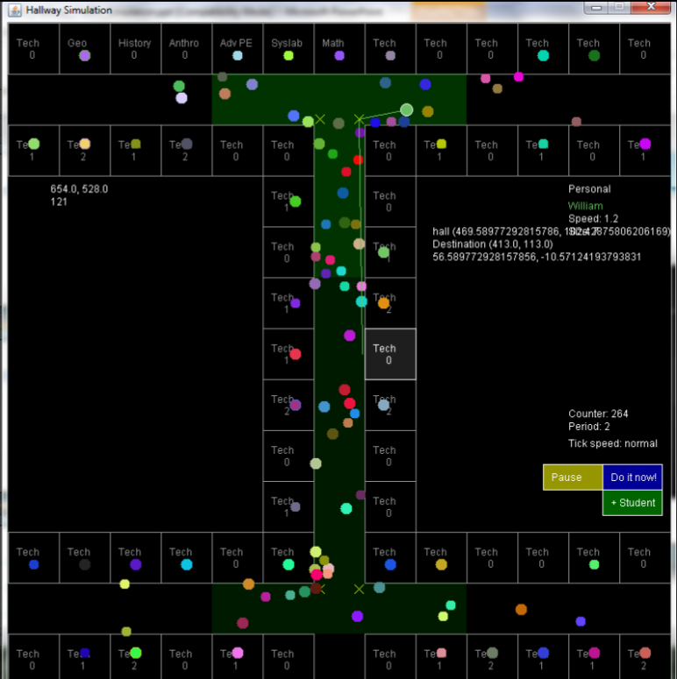
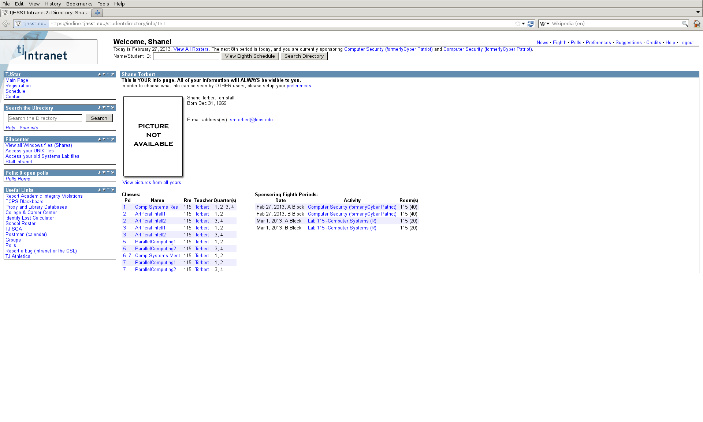
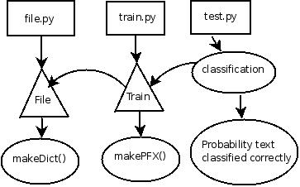
Welcome to the
Computer Systems Lab
www.tjhsst.edu/compsci
Research and Mentorship
Projects fall within a broad spectrum of computer science spanning
artificial intelligence and machine learning, computer vision, graphics,
high performance computing, grid/distributed computing, computational
science applications, agent based modeling of complex systems such
as social complexity, software design, and the development of theoretical
algorithms. We emphasize a multilingual computer language community.

