Slide 1
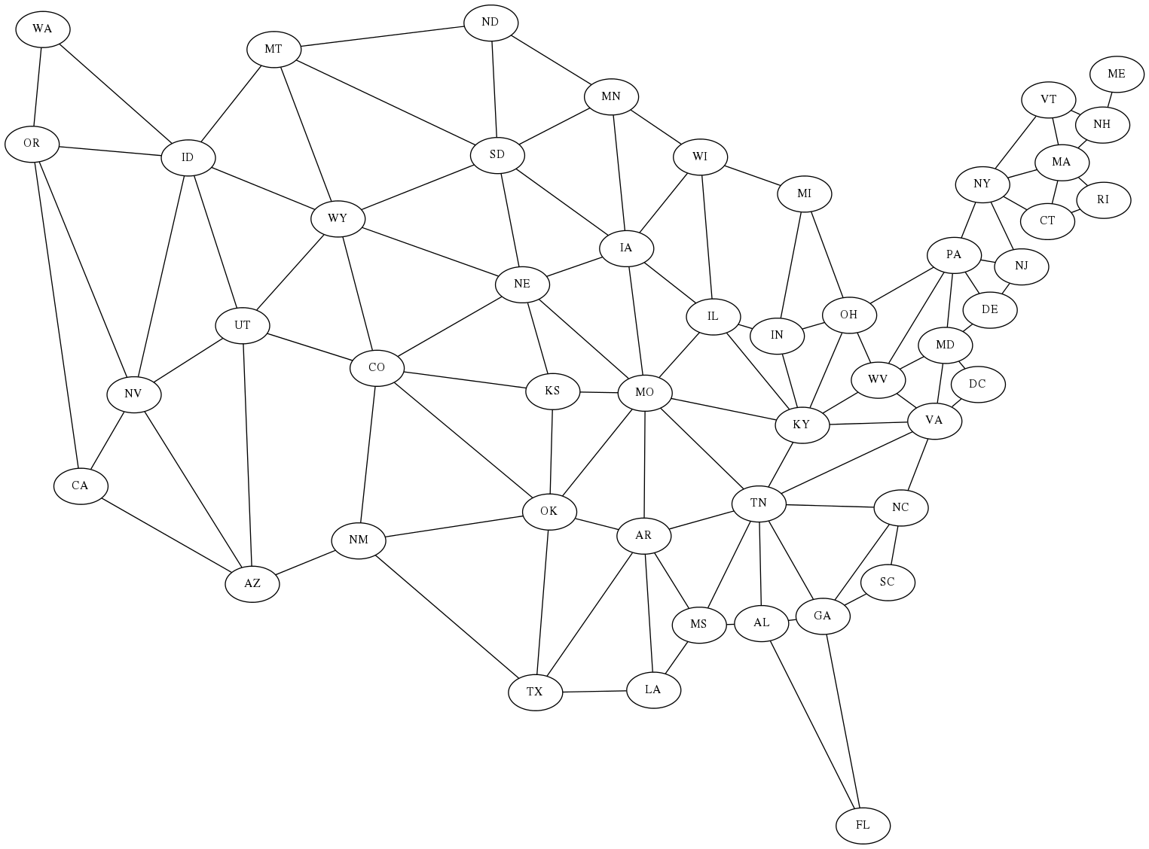
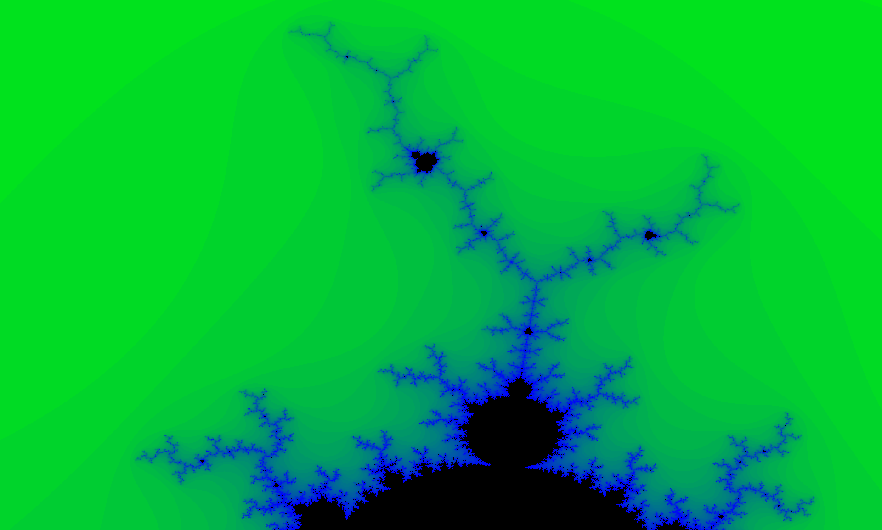
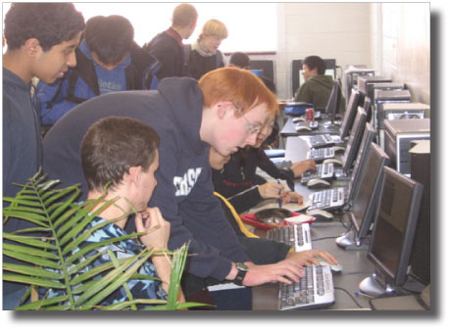
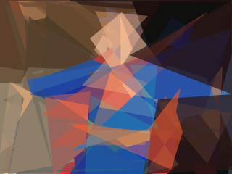
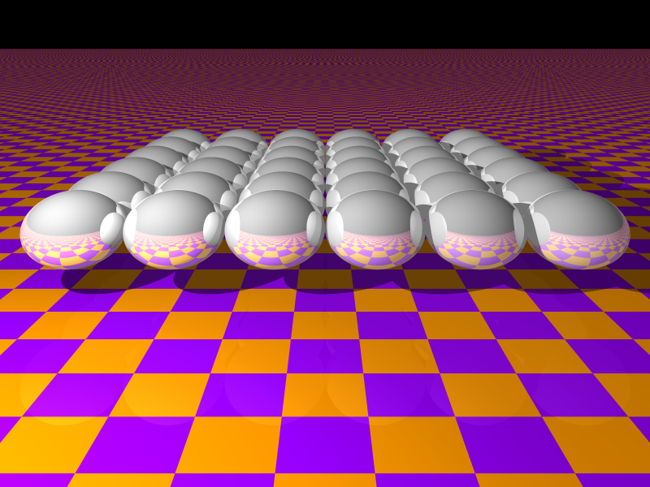
Artificial Intelligence
Parallel Computing
Graph node edge neighbor
Heuristic search shortest path
Efficiency heap priority queue
Recursion constraint solvers
Minimax game tree pruning
C pointer array memory tree
Manager worker MPI rank
Send receive data parameter
Nearest neighbor coupling
Grid 2-d interactive OpenGL
Welcome to the
Computer Systems Lab
www.tjhsst.edu/compsci
Image processing pixel color
Threshold edge angle shapes
Optimization local global scale
Evolutionary algorithm iterative
Neural network layers learning
Ray tracing 3-d render scene
Particle to particle interaction
Field solver cellular automata
Cache miss and false sharing
XMT OpenMP threads CUDA

