Slide 1
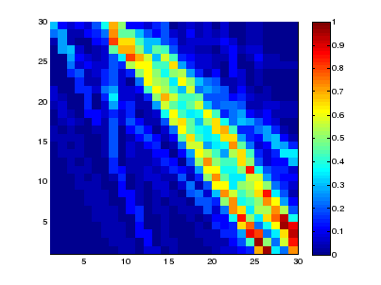
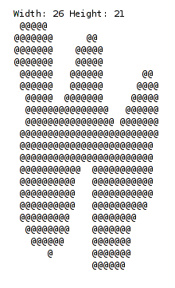
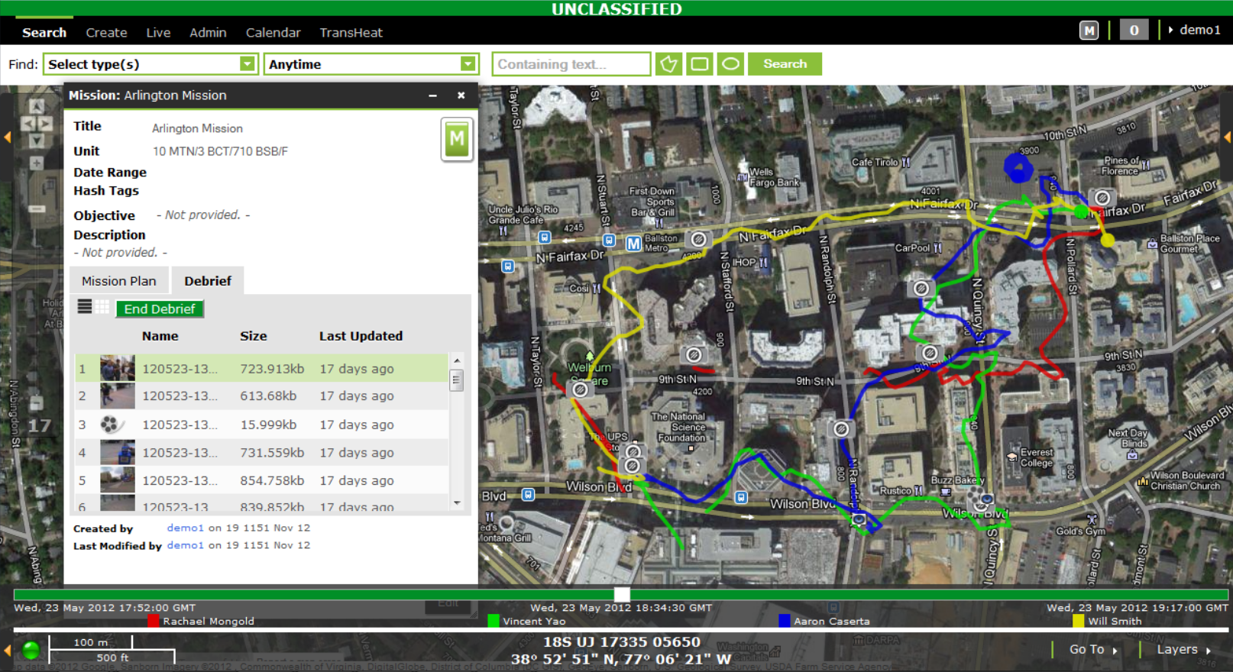
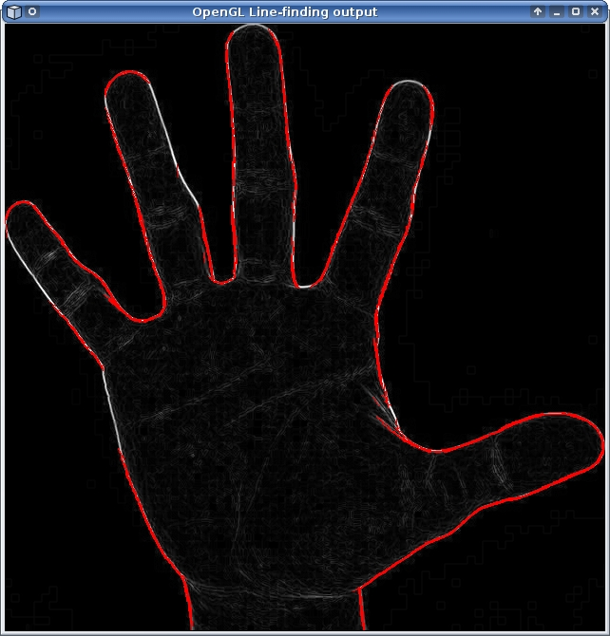
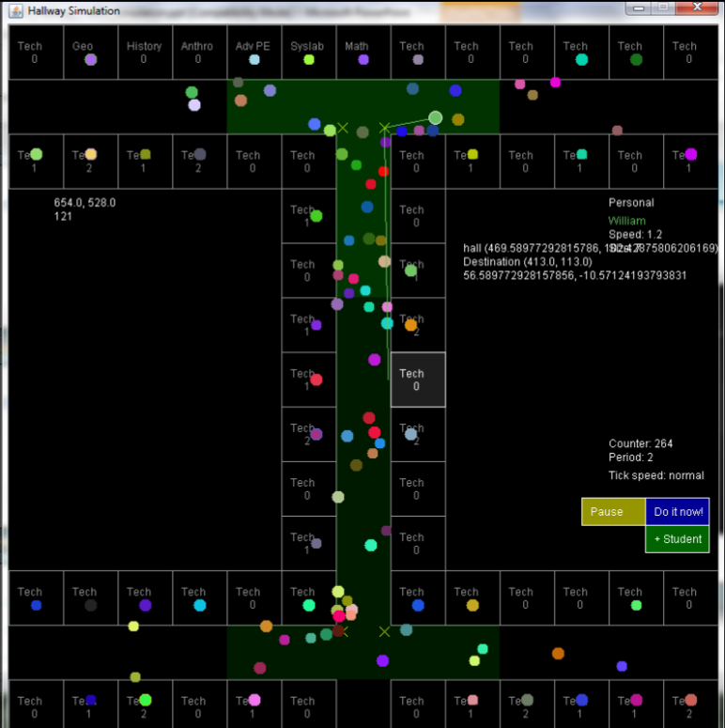
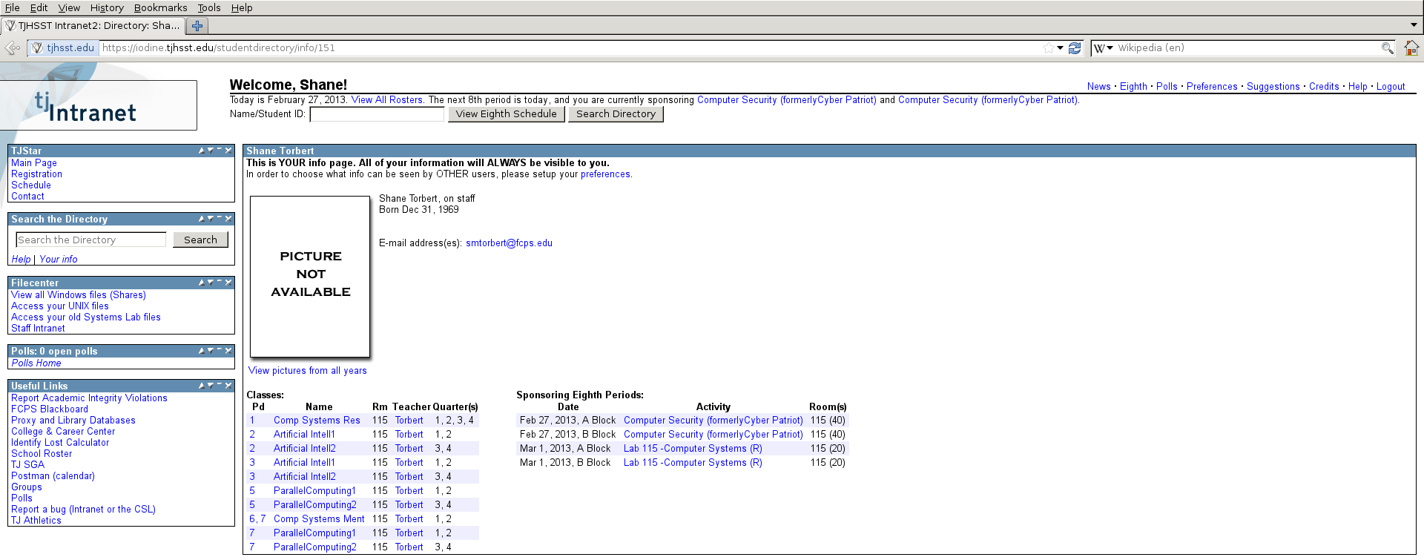
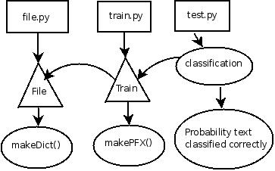
Welcome to the Computer Systems Lab www.tjhsst.edu/compsci
Research and Mentorship
Projects fall within a broad spectrum of computer science spanning
artificial intelligence and machine learning, computer vision, graphics,
high performance computing, grid/distributed computing, computational
science applications, agent based modeling of complex systems such
as social complexity, software design, and the development of theoretical
algorithms. We emphasize a multilingual computer language community.

Slide 2
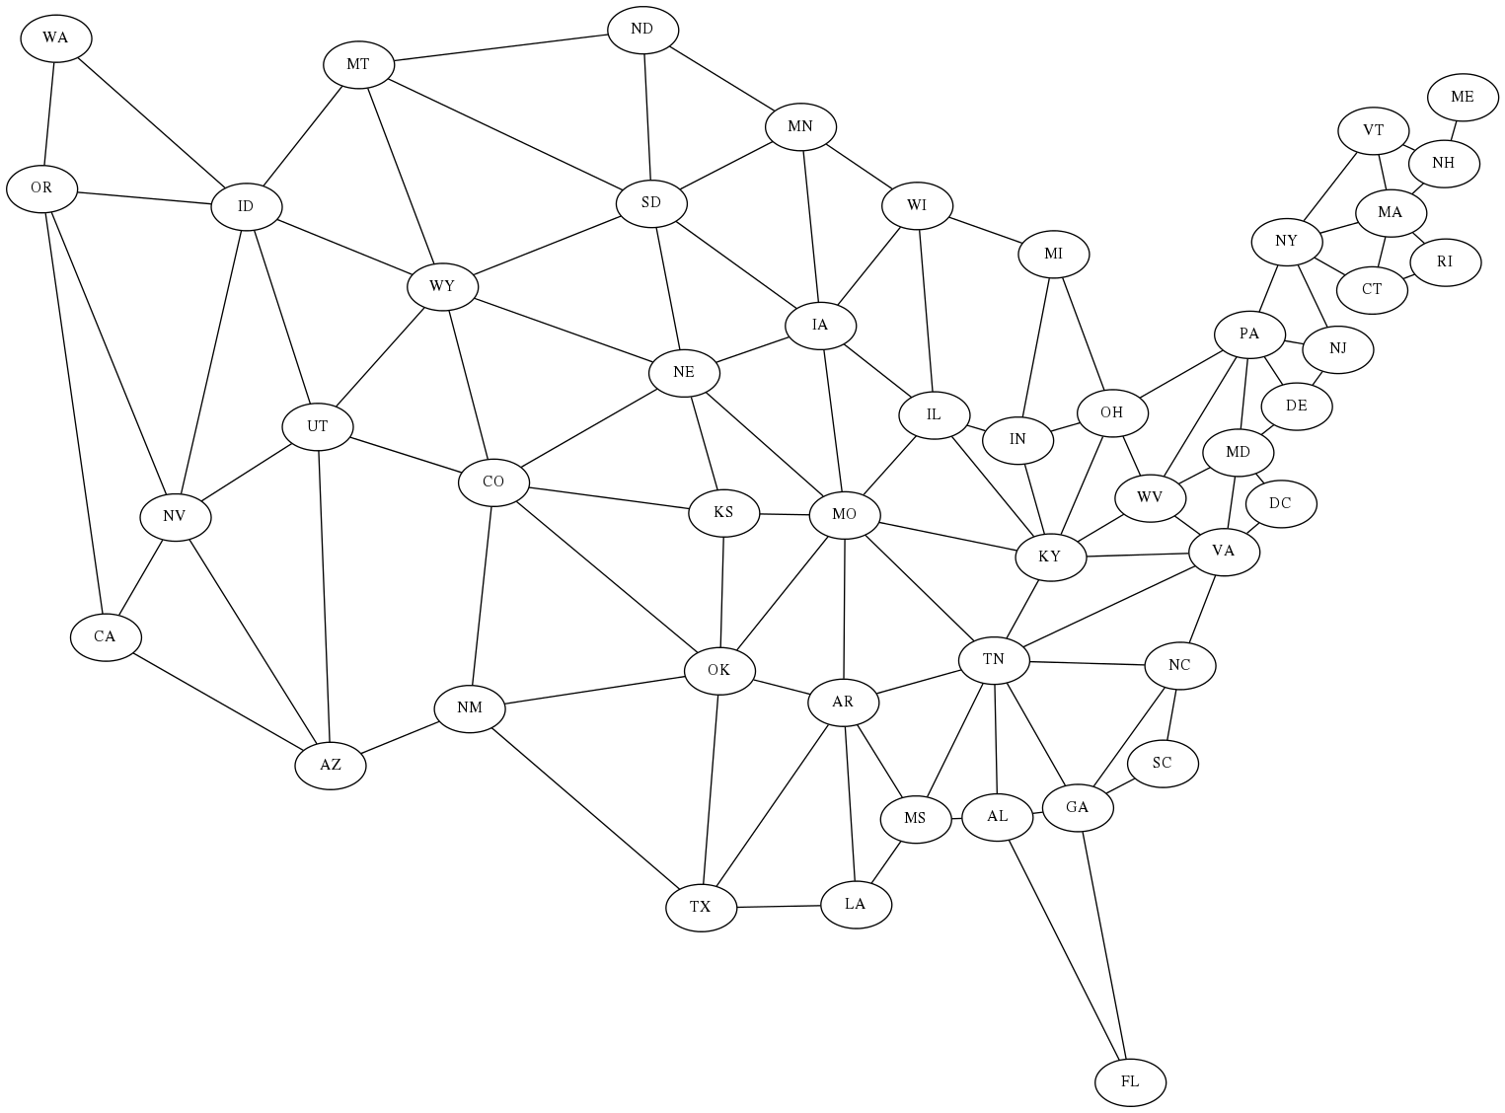
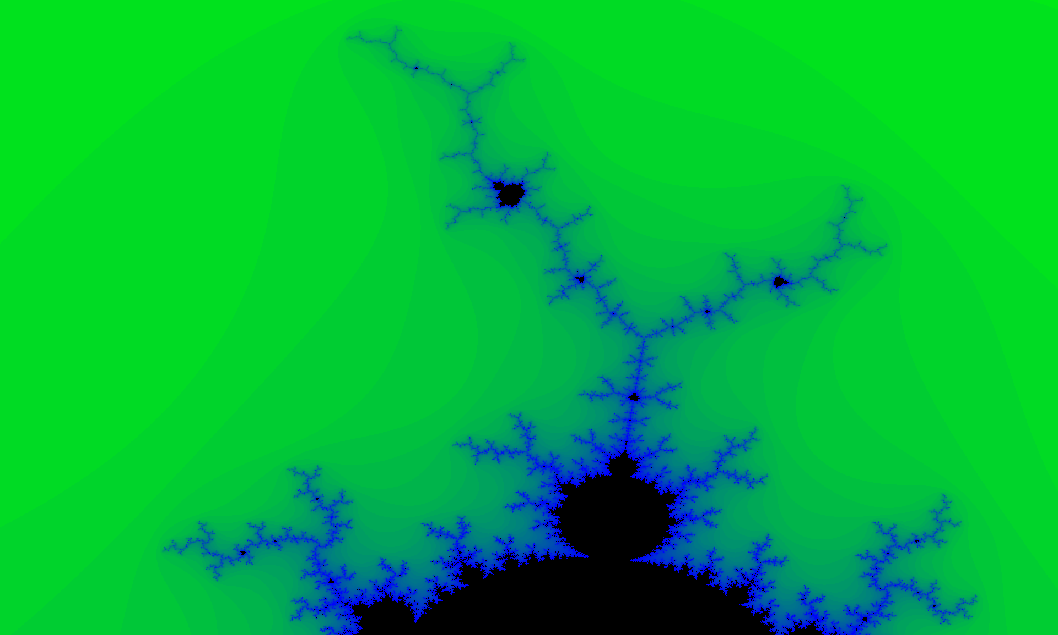
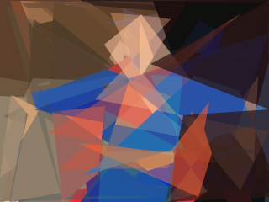
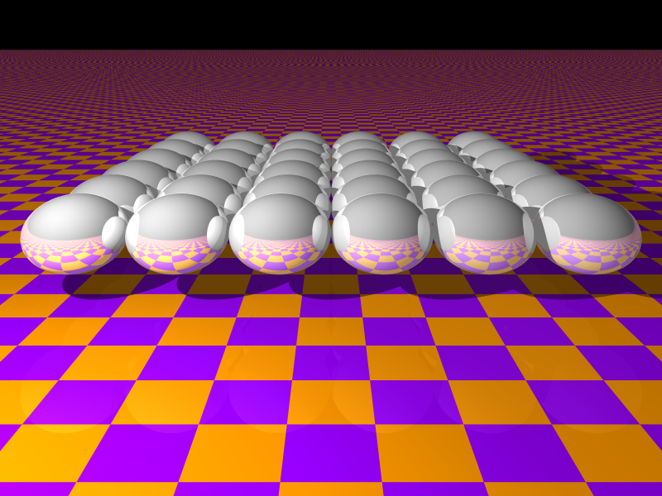
Artificial Intelligence 1, Fall
Parallel Computing 1, Fall
Graph node edge neighbor Heuristic search shortest path Efficiency heap priority queue Recursion constraint solvers Minimax game tree pruning
C pointer array memory tree Manager worker MPI rank Send receive data parameter Nearest neighbor coupling Grid 2-d interactive OpenGL
Artificial Intelligence 2, Spring
Parallel Computing 2, Spring
Image processing pixel color Threshold edge angle shapes Optimization local global scale Evolutionary algorithm iterative Neural network layers learning
Ray tracing 3-d render scene Particle to particle interaction Field solver cellular automata Cache miss and false sharing XMT OpenMP threads CUDA

